Slide 1
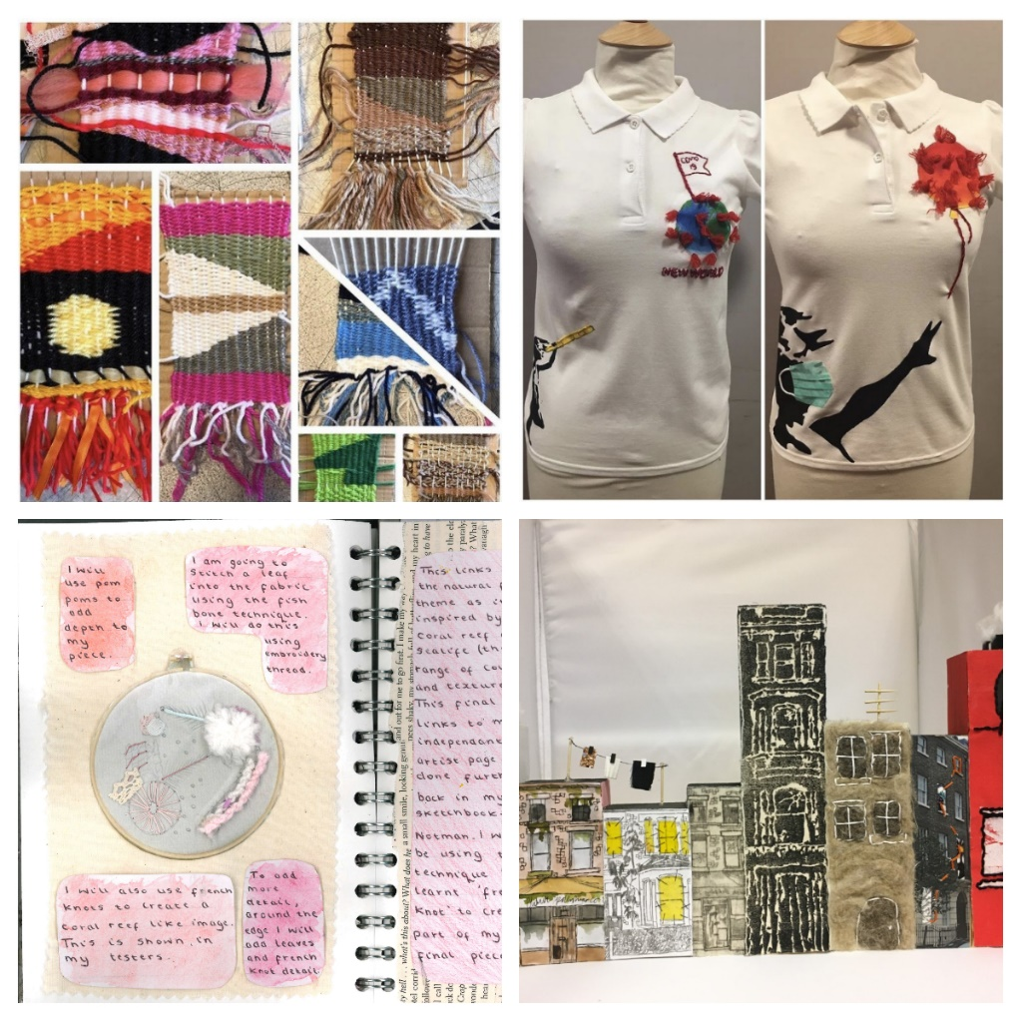
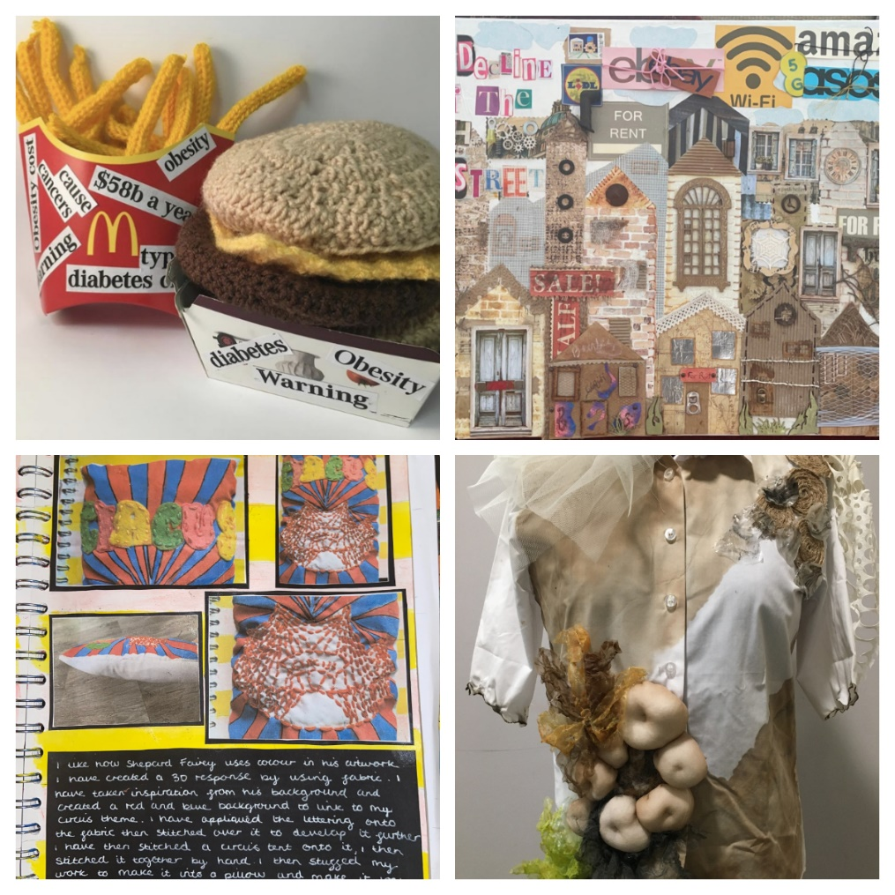
Art Textiles

Slide 2
Our Inspiring Curriculum
KS4 Art Textiles GCSE
’The AQA GCSE Art Textiles is a vibrant and dynamic, course that gives students the freedom to explore the subject in ways that inspire and bring out the best in all students, whilst equipping them with the skills to continue the subject with confidence at AS, A-level and beyond. There is a full range of options open to students, which allow for the study of Art Textiles in both breadth and depth. Portfolio projects, assignments or briefs can be open-ended or more narrowly focused. There is no restriction on the choice of media, scale or format that students use to reflect and evidence their submissions.’
This specification encourages students to:
actively engage in the creative process of art, craft and design in order to develop as effective and independent learners, and as critical and reflective thinkers with enquiring minds
develop creative, imaginative and intuitive capabilities when exploring and making images, artefacts and products
become confident in taking risks and learn from experience when exploring and experimenting with ideas, processes, media, materials and techniques
develop critical understanding through investigative, analytical, experimental, practical, technical and expressive skills
develop and refine ideas and proposals, personal outcomes or solutions with increasing independence

Slide 3
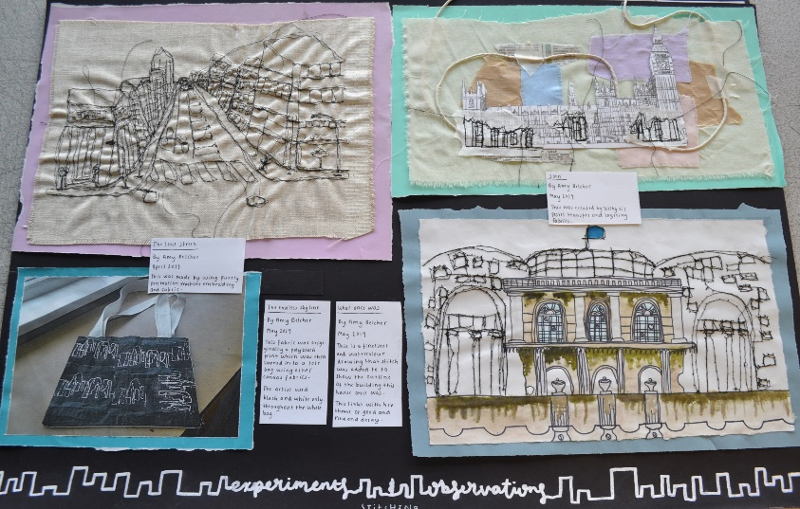
Our Inspiring Curriculum
Students will be assessed through a personal learning checklist for each unit of work, grading their progress based on a RAG rating and a teacher digital tracker. A formal assessment of each unit will take place using the 4 GCSE assessment objectives.
Component 1: Portfolio 60% of qualification: 120 marks
This component comprises a major practical portfolio based on 2 internally set themes. This component will be internally set, internally assessed and externally moderated. Work will be selected, evaluated and presented for assessment by the student. Evidence is required of how the student has met each of the assessment objectives.
Component 2: Externally Set Assignment 40% of qualification: 80 marks
Part 1: Preparatory study period
Externally Set Assignment materials by the exam board. One of the assignments is to be selected by the student and are developed during the preparatory study period which inform the resolution of the student’s ideas in the 10 hour exam.
Part 2: 10 hour period of sustained focus work
The resolution of the student’s ideas from the preparatory work must be completed during the designated 10 hours of sustained focus work under supervised conditions.

Slide 4
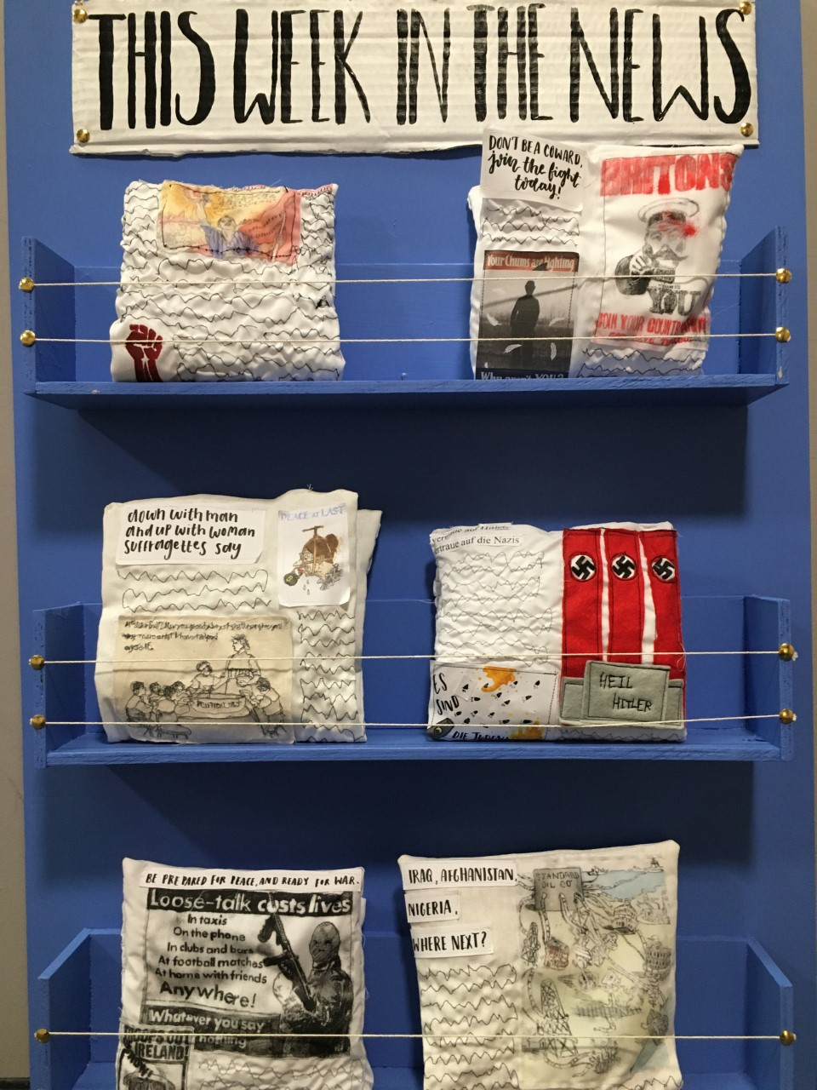
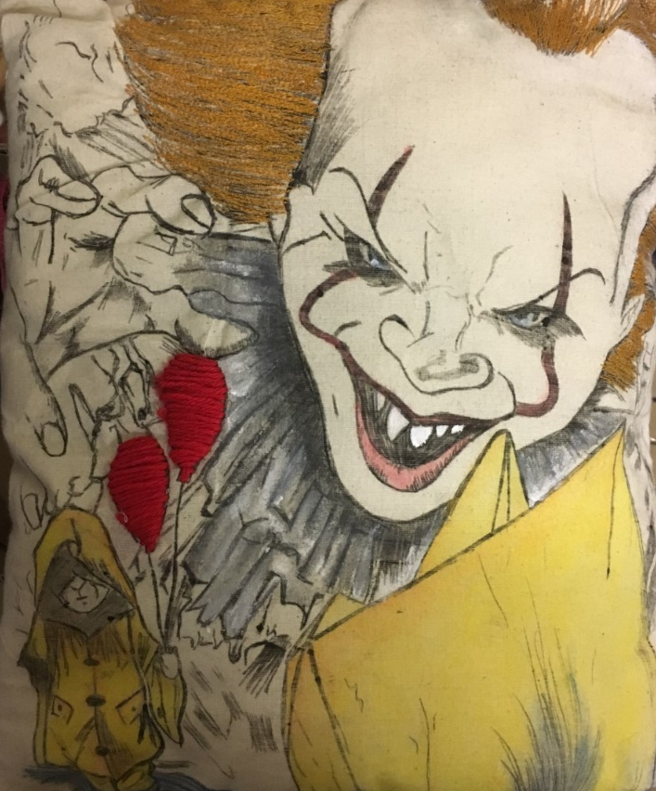
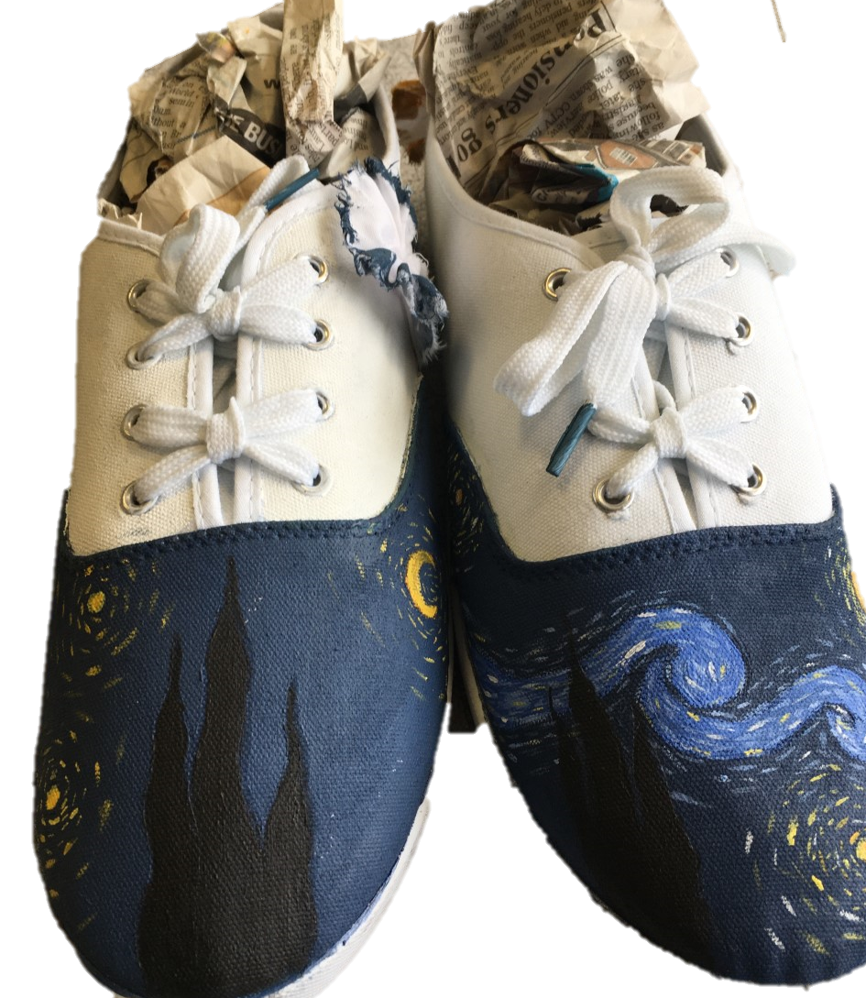
Challenge

Slide 5
What our students think…
“Its very fun and relaxing, helps you learn lots of new skills”
“Take Art Textiles because it increases academic diversity and provides a creative outlet and a way to present your own ideas”
“I like Textiles because I can express myself through my work”
“It’s a very soothing subject, as it allows you to express and experiment with your own ideas”
“You should take Art Textiles because you learn so much about different medias and artists. Also its benefitted me because its more expressive and individual”
“More practical then academic and you get more creative control over your work”
“It allows you to have more open option choices for A-Level”

Slide 6
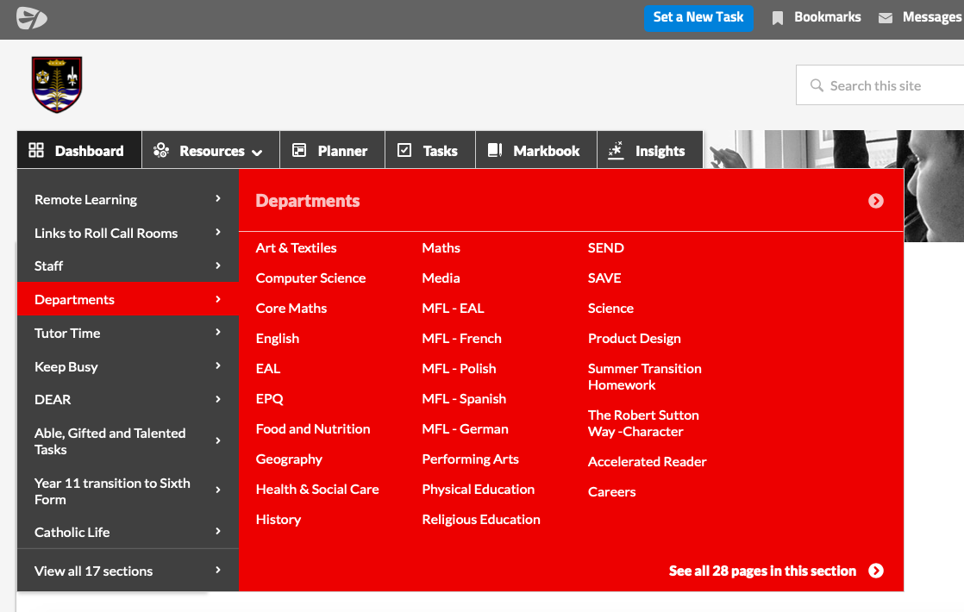
Examples of inspiring work

