Slide 1
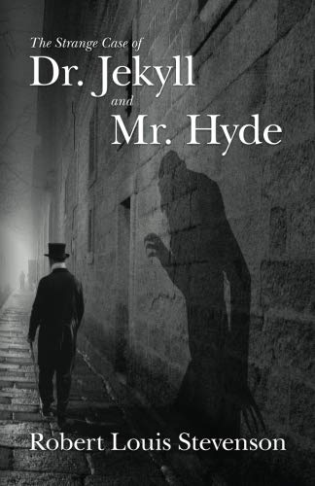
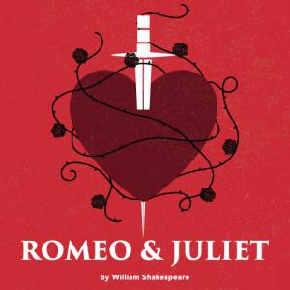
English
AQA GCSE English Literature
You will study:
A Modern Text (‘Blood Brothers’ or ‘Animal Farm’)
A Shakespeare play (‘Romeo and Juliet’ or ‘Macbeth’)
‘Jekyll and Hyde’
15 Poems from the anthology ‘Power and Conflict’
AQA GCSE English Language
You will study:
Unseen Fiction writing
Unseen non-fiction writing
Descriptive writing
Persuasive writing

Slide 2
Our Inspiring Curriculum

Slide 3
Our Inspiring Curriculum
In Year 10 study, students begin by studying a Modern Text (Literature Paper 2 Section A) (‘Blood Brothers’ or ‘Animal Farm’). The teacher, using knowledge of the class’ ability and interest, decides on the text chosen for each group. This way we can ensure that students are studying texts that are accessible to them, and offer them opportunities to engage fully with the text.
We start GCSE study with this element of the Literature exam to help students settle into the new curriculum, as they have previously studied modern texts at KS3. The demands of the exam for this text are challenging – this is the only literature question whereby students do not have a copy of the text, therefore, starting the two year course with this allows students maximum opportunity to revise and hone their skills in assessments in Year 10 and Year 11.
After the Modern Text, students study the 19th century text ‘Jekyll and Hyde’ (Literature Paper 1 Section B). By this stage in their academic career, students should be increasingly confident and proficient at reading texts, and their understanding of Victorian society is well honed from KS3 study
For the Language curriculum, lessons in Year 10 focus on the first paper, which is fiction comprehension and creative writing.
Year 11 begins with the study of the Shakespeare element of the Literature course (Literature Paper 1 Section A). Classes either study ‘Macbeth’ or ‘Romeo and Juliet’, depending on their ability. Using the longest two half terms of the school year allows for teaching to be thorough and learning to be effectively secured, helping students to grasp the plot and key ideas. Students often find this aspect of the curriculum difficult, and therefore much time is dedicated to ensuring a strong grasp on the text is established
Finally students study the 15 poems in the ‘Power and Conflict’ anthology (Literature Paper 2 Section B), while developing skills for Unseen Poetry (Literature Paper 2 Section C). The poems are taught in a sequence that allows links to be drawn between each, and therefore allow students to develop their skills of comparison through the journey of learning. The teaching of comparison in Literature marries well at this point with the comparison skills established through the study of Language Paper 2, which is an exam based on comparing two sources.
For the Language curriculum, lessons in Year 11 focus on the Language Paper 2, which is comparison non-fiction comprehension and persuasive writing.
Assessments
• Students are assessed at 3 points in each year of GCSE study, in line with SPC deadlines.
• All assessments are in the style of the exam, and are conducted in exam conditions.
• Testing is cumulative over time, with each SPC revisiting previous texts.
• Regular marking of students’ books ensures teachers track progress within lessons

Slide 4
Challenge and Enrichment
Enrichment opportunities
Theatre visits to see the plays studied in performance
Author visits for creative writing
KS4 Book Club
Literacy Ambassadors

