Slide 1
Fire Alarms – How we do them! Staff Guidance

Slide 2
In the event of a fire
Activate the nearest alarm system.
All staff assist in clearing the building.
Close all doors and windows (DO NOT LOCK)
Proceed to the bus park
Make sure room is empty of pupils
Turn off any gas if applicable
Safety from a Fire is more important than following preventative measures for COVID-19

Slide 3
Exit routes to the bus park
When the Fire Alarm sounds get out of the building via the nearest fire exit:
. From any exit in the Sutton block, proceed to Bluestone Lane, cross with care, and access the Bus Park through the gate.
2. Groups in A111 and A112 to exit around the rear of the Gym and Sports Hall then along the lane.
3. Students and staff exiting from the front of the Sherwin Block – go along Bluestone Lane to the gate.
4. Students and staff exiting from the Side Door of the Sherwin Block – go through the Green Gate and over the field to get to the Bus Park.

Slide 4
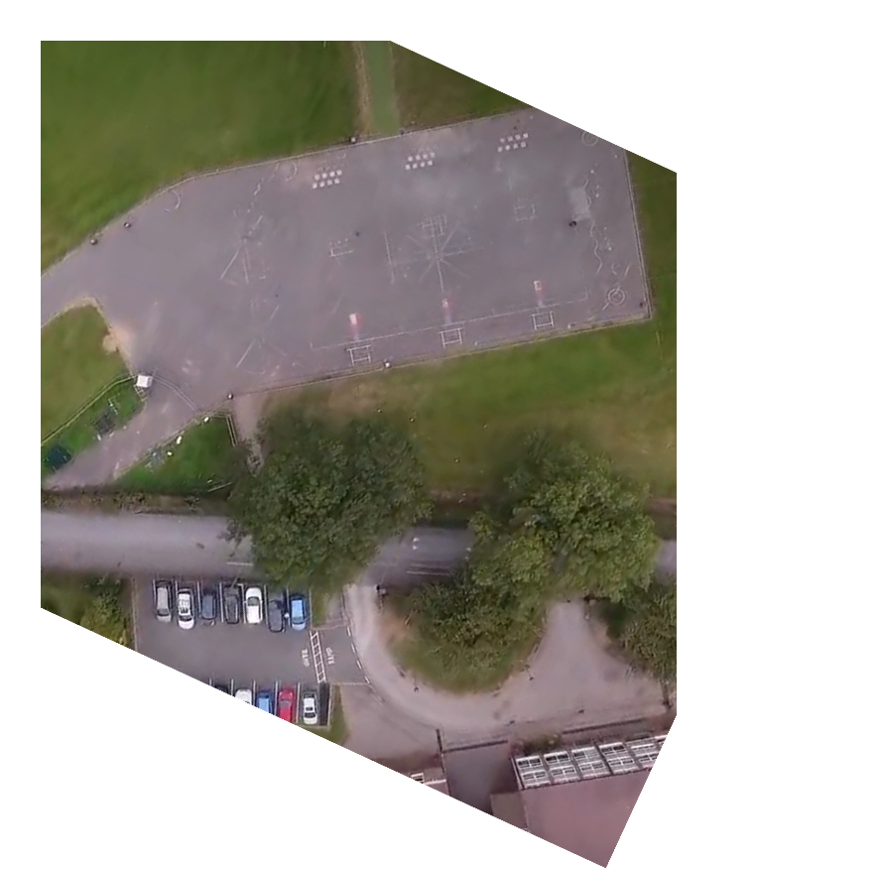
Where do you stand?
10.1 10.2 10.3 10.4 7.1 7.2 7.3 7.4
11.1 11.2 11.3 11.4
ALL PUPILS MUST STAND IN THE DIRECTION OF THE CENTRE OF THE BUS PARK
Tutors – this afternoon you may want to take your form outside to show them where to stand in the event of a fire alarm
9.1 9.2 9.3 9.4 9.5 8.1 8.2 8.3 8.4
Make sure there is at least 1 metre between forms.

Slide 5
Those with forms
Before a fire
Prepare your form. Do they know where to stand? Do they know
alphabetical order? Do they understand single file and silence? Do they know to stand facing the centre of the playground so they can hear key messages from SLT?
During a fire
Stand with your forms – Year Leaders will give you your register
Complete register
Stay with your form – Year Leaders will collect your register
Tell Year Leader of any missing students
Proactively ensure form is silent and behaving until directed otherwise
Stay with your form until they are dismissed

Slide 6
Year Leaders
See Admin Lead to get registered.
Pick up registers from Admin Team. Year Leaders to distribute to Form Tutors in Year group.
Go to front of year group, collect in registers and return to Jake Heath - highlighting any missing students and staff.
Admin Lead to report any missing staff to Laura O’Leary.
Proactively ensure year group is silent and behaving

Slide 7
SLT
Register with Admin Lead
Circulate across each year group
HT to remain in centre of bus park

Slide 8
All teaching staff including teaching assistants without forms
See Admin Lead to get registered
Spread out amongst year groups to proactively support and ensure silence

Slide 9
Staff covering a form
If you have completed a register in the morning and there is a fire alarm. Please cover that form.

Slide 10
All teaching staff including teaching assistants without forms
See Admin Team to get registered
Spread out amongst year groups to proactively support and ensure silence

Slide 11
All other support staff
This includes Admin, Support Technicians, IT support, Kitchen and Premises staff.
See Admin Team to get registered
Spread out amongst year groups to proactively support and ensure silence, best to stand behind the students.
Admin Lead to report any missing staff to HT.

Slide 12
All other staff and visitors
See Admin Team to get registered. Admin Team will be located on the bus park.
Stand At the side of students. Please remember that students are expected to be in silence, we should model to the students how to conduct themselves by leading by example.
If you have parents, please treat them the same as any other visitor, however if you have a different role, please leave with Lynette Field and at the end come back and collect them.
Lynette Field to report any missing visitors to Laura O’Leary.

Slide 13
At the end
The Headteacher to inform staff once they can re-enter once all clear has been given by fire officers.
Forms to be dismissed by SLT and led back inside by tutor, starting from either end, one form at a time.

Slide 14
Fire alarms before school
The fire alarm is tested regularly at approximately 7.15am by a short series of short rings. If the alarm sounds continuously for more than thirty seconds, at any time, this means it is not a practice.
Therefore, do not stop to collect your belongings. Leave the building immediately by the nearest available fire exit and assemble on the bus park.
Registers will be taken for pupils and office staff will check that all staff and visitors are present. You will be advised by the Site Team when it is safe to re-enter the building.
If you leave the site during the school day you must ensure that you sign in and out
of Reception to ensure that we know your whereabouts in the event of a fire.

Slide 15
Fire alarms after school
If the fire alarm sounds after the school day, please assemble on the bus park.

Slide 16
Accounting for everyone
Fire Officers and Headteacher assess the situation
Claire Mills
Admin Lead
1. Sharon Milligan
Cover (HB / JT)
SLT
Year Leaders
Teaching Staff
Check that all pupils are present in year group
Office staff
It is essential that we quickly account for everyone in the building. Therefore below, everyone has someone to report to.
Fire officers to make contact with Headteacher. They assess the situation.
Form Tutors to collect registers from Year Leaders.

Slide 17
Cover arrangements
Should Jake Heath be away – Laura Wilson to cover
Should Claire Mills be away – Sharon Milligan to cover
Should Sharon Milligan be away – Helen Blackham / Jan Talbot to cover
Should Lynette Field be away – Jan Talbot to cover

