Slide 1
Welcome Evening
Tuesday 1st July 2025
Class of 2025-2030
A warm welcome to our new Y7 children, parents and families

Slide 2
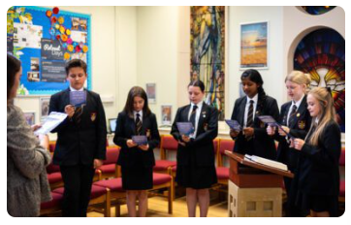
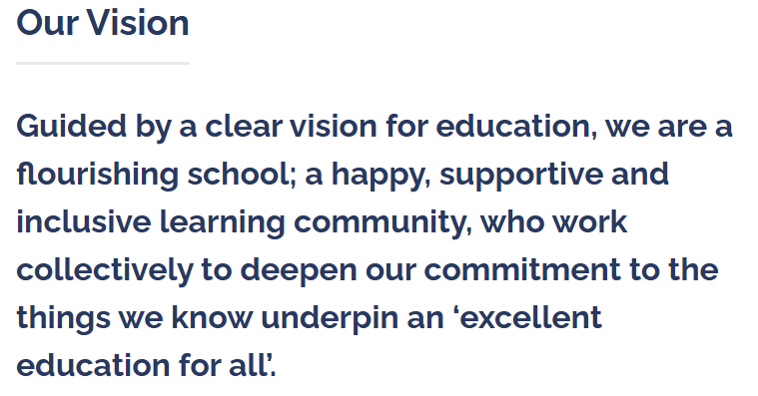
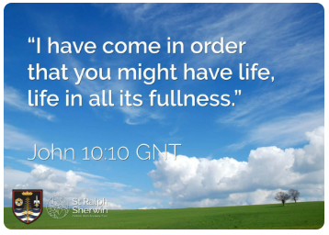
Headteacher’s Welcome

Slide 3
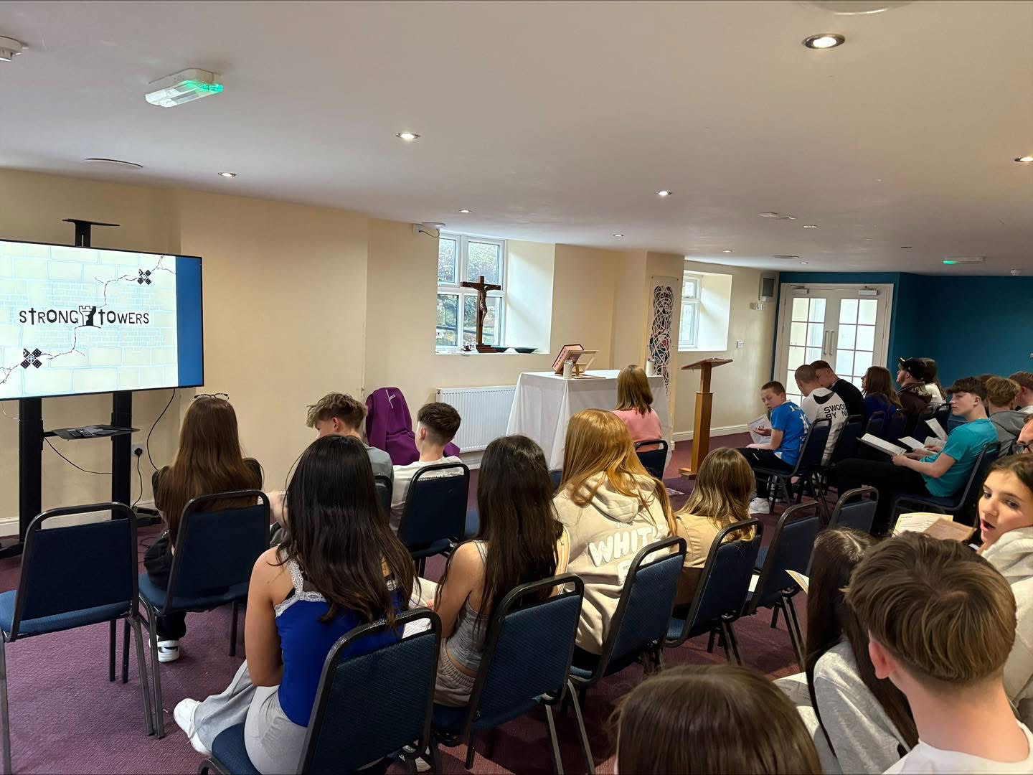
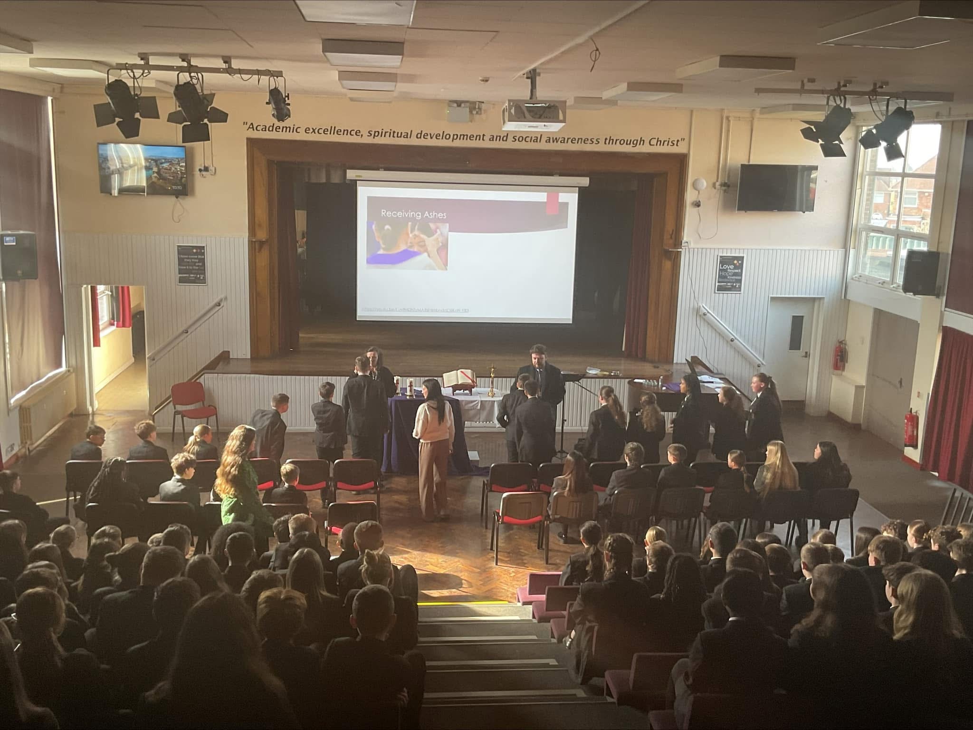
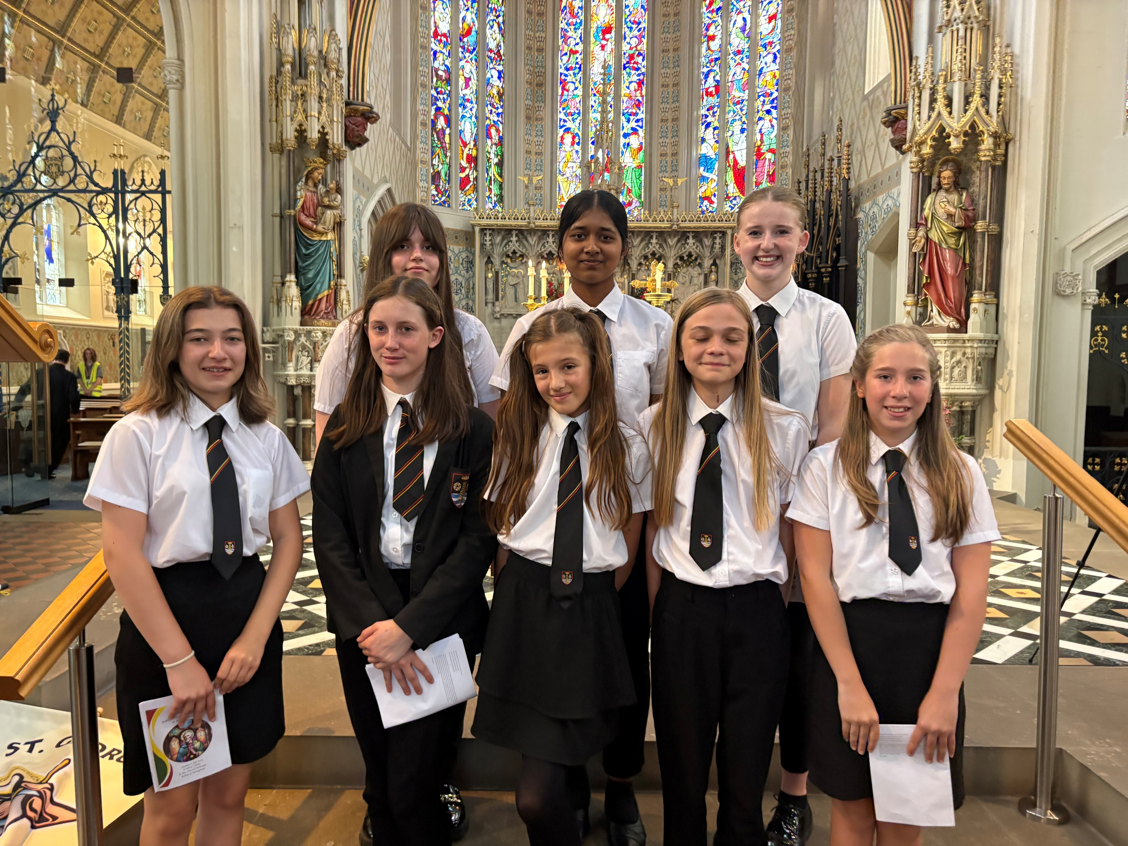
Catholic Life and Mission

Slide 4
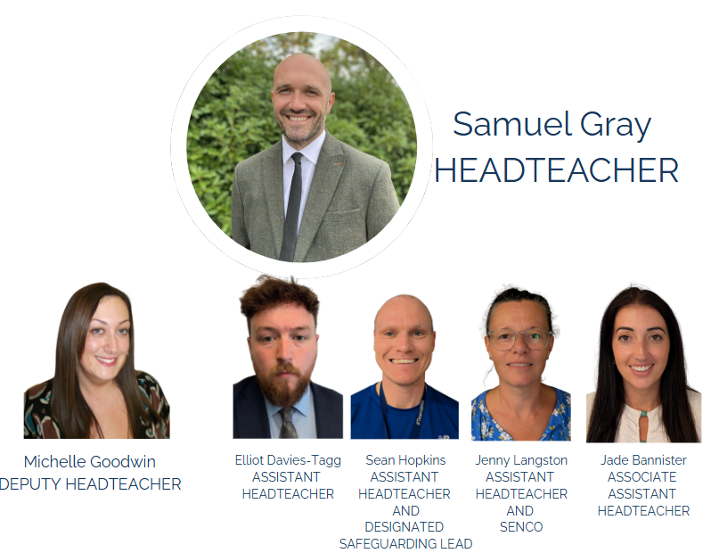
Key Staff

Slide 5
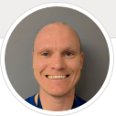
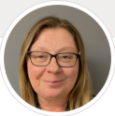
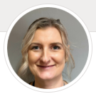
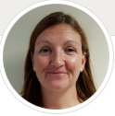
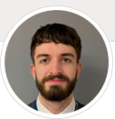
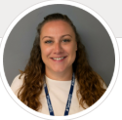
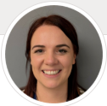
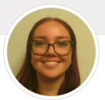
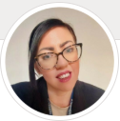
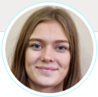
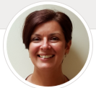
Safeguarding and Pastoral Support
Safeguarding Team
Mr Hopkins
Designated Safeguarding Lead
Mrs Smith
Deputy Designated Safeguarding Lead
Form Tutors –
7.1 - Mrs V. Kaliaperumal (Mrs K)
7.2 - Mrs E. Goddard
7.3 - Mr C. Jimenez
7.4 - Mr C. Simpson
Head of Year – Amanda Macdowall
Mrs Miller
Assistant SENCO
Mrs Rowe
Attendance Officer
Pastoral Team
Mr Mills
Miss Upton
Mon, Thu, Fri
Mrs Kucharik
Tues & Wed
Extended Safeguarding Team
Miss Page
Teaching
Assistant
Mrs Gibson
Teaching
Assistant
Miss Miller
Teaching
Assistant
Mrs Brown
Pastoral
Support

Slide 6
Journey to BRS
Since April 2025
Contact with primary school’s – key information sharing
Visits to primary schools and speaking with students
Contact between school SENCo’s for additional information sharing
Contact with you as parents
Enhanced Transition Day
Our evening tonight
Transition Day tomorrow

Slide 7
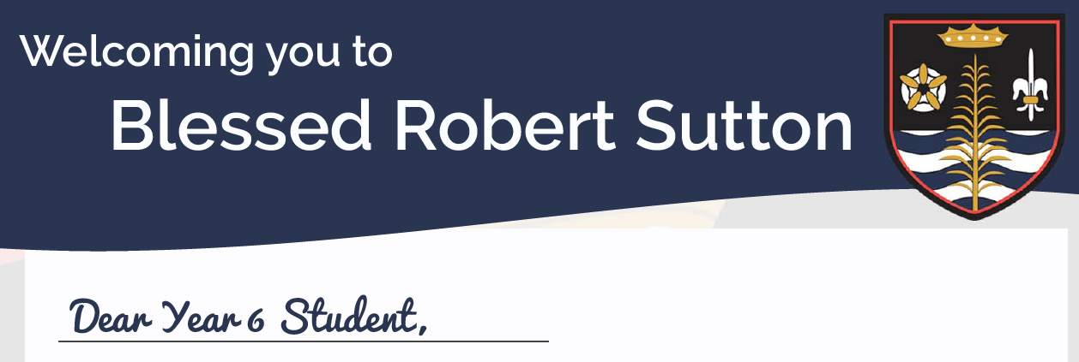
Transition Pack
Transition challenge booklet
Letter from a BRS pupil
Book
Key school information
Disco invitation

Slide 8
Transition Pack
Transition challenge booklet
Letter from a BRS pupil
Book
Key school information
Disco invitation
Booklet explaining RE & Catholic Life

Slide 9
Wednesday 2nd July
Arrive by 8:25am
Drop off at main gates – students to head to reception
Free meal – bring snack for break as cashless system in school
5 lessons during the day
Finish at 2:30pm
Year 6/7 Disco 6-8pm including tuck shop

Slide 10
Wednesday 3rd September
Arrive by 8:25am
Drop off at main gates – students to head to reception
Students will have their finger print taken and those without permission given a code. ParentPay letters will be sent home during the first week to add money to your child's account
Students should, where possible, travel by bike, on foot or via public transport.
If driving is the only option please park away from the school lane.

Slide 11
ARBOR
Communication system – main way of communication with parents
Log in details will be provided in September – log in to ensure messages from the start of term are received.
School Website - https://www.robertsutton.srscmat.co.uk/
Also social media – Facebook/Instagram & X (formally Twitter)
Facebook – Blessed Robert Sutton
Instagram – blessedrobertsuttonschool
X - @BRS_staffs

Slide 12
Day in the life of a BRS student
Time | Event | Instructions
8:25-8:50am | Line ups and AM Form | 8:20am warning bell
8:50-9:45am | Period 1
9:45-10:40am | Period 2
10:40-10:55am | Break – | 10:55am warning bell
10:55-11:00am | Change over from break
11:00-11:55am | Period 3
11:55am-12:50pm | Period 4
12:50-1:25pm | Lunch | Warning Bell at 1:25pm Whistle 1:27pm Students silent at 1:30pm
1:30-1:35pm | Line ups and uniform checks by Form Tutors
1:35-2:30pm | Period 5
2:30-2:55pm | PM form time

Slide 13
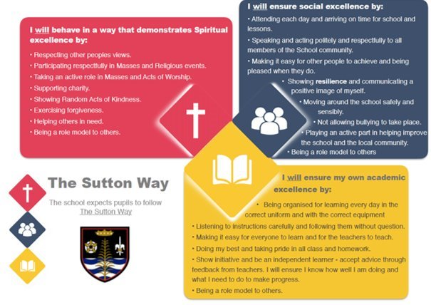
Our Pupils follow The Sutton Way
To help with this pupils will take part in a Sutton Start Bootcamp

Slide 14
Form times at BRS
Morning sessions – Tutor Time Read Programme and Act of Worship
Afternoon sessions – Activities linked to the theme of the day

Slide 15
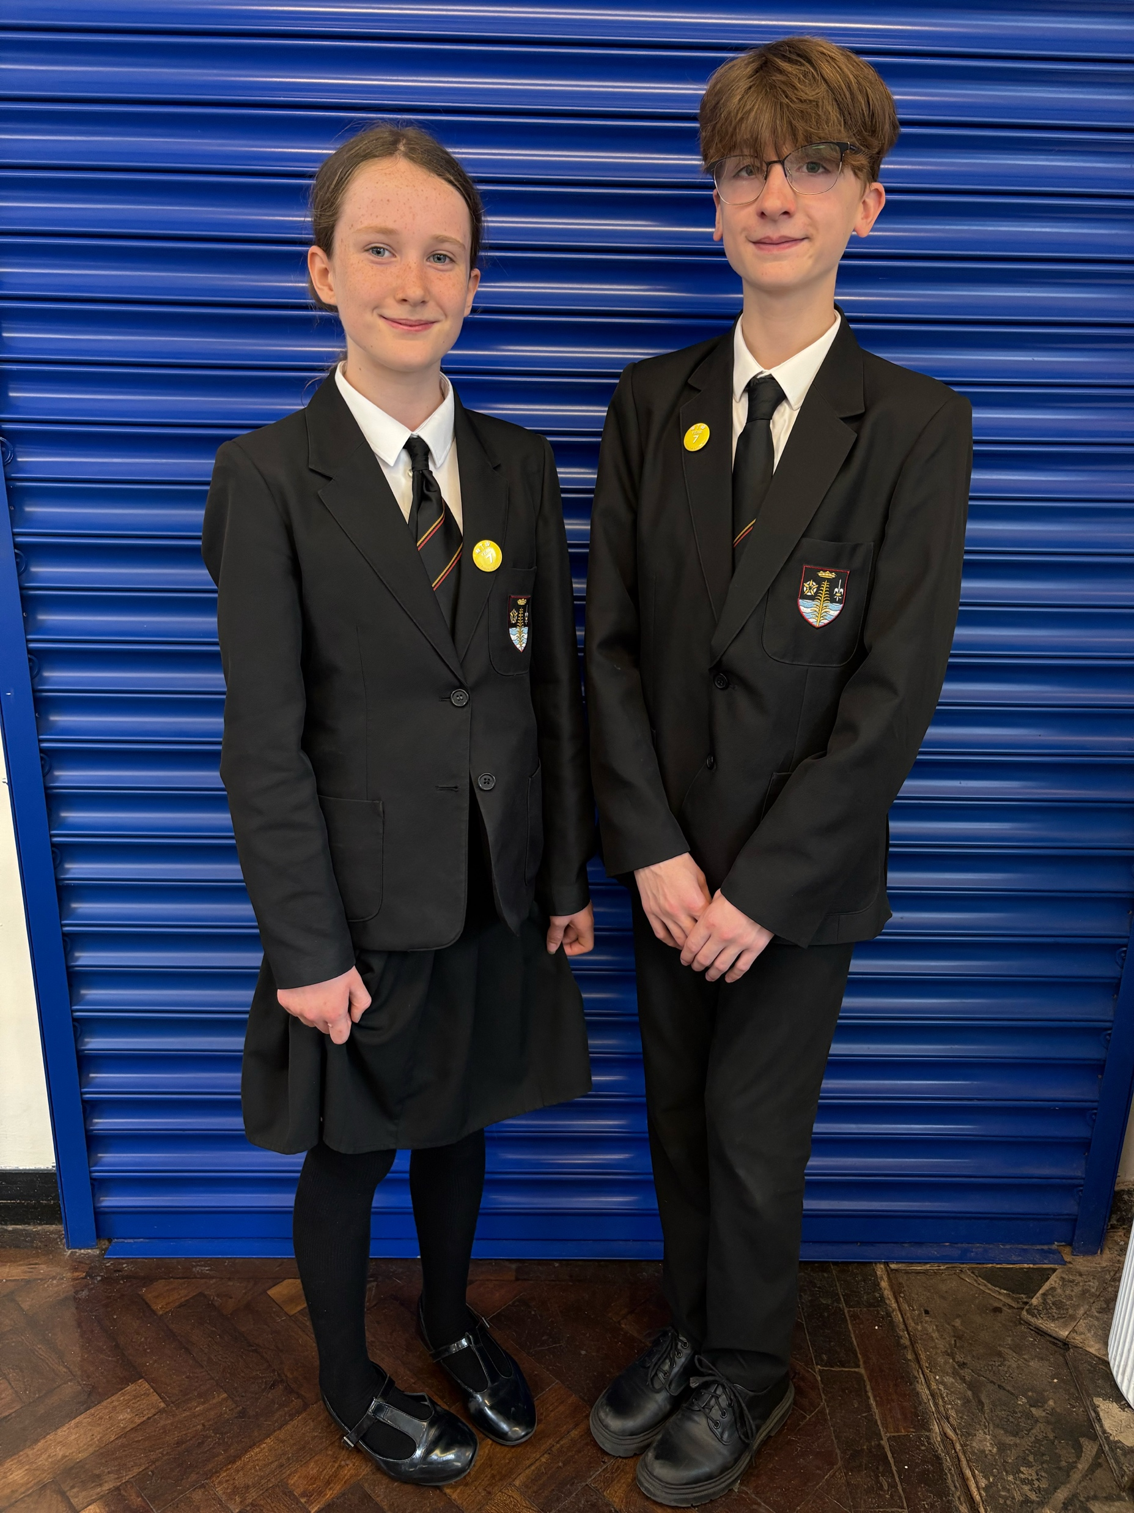
Uniform
The uniform supplier for Blessed Robert Sutton is Pupil Schoolwear in Swadlincote.
Opening hours are
Monday-Friday 9:30-5pm
Saturday 9:30-5pm.
Offering the bundle price for BRS uniform code is PSW25

Slide 16
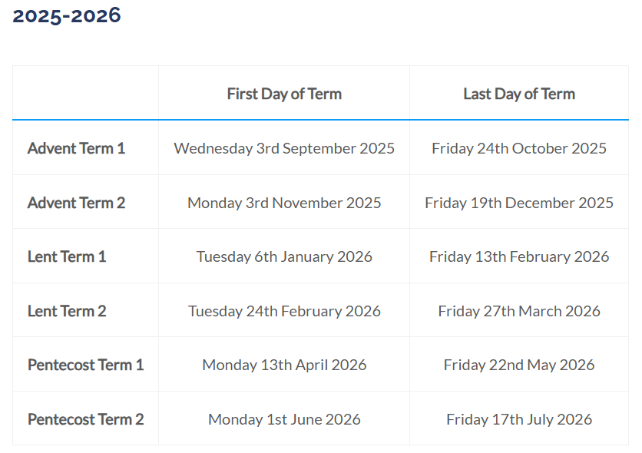
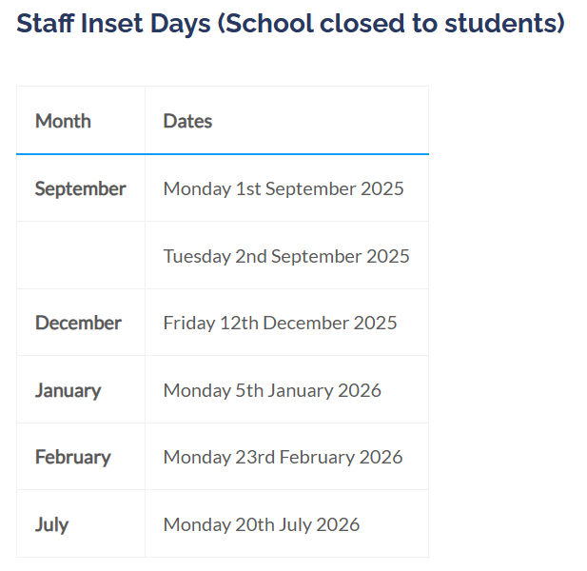
Term Dates 2025-26
https://www.robertsutton.srscmat.co.uk/parents/term-dates/

Slide 17
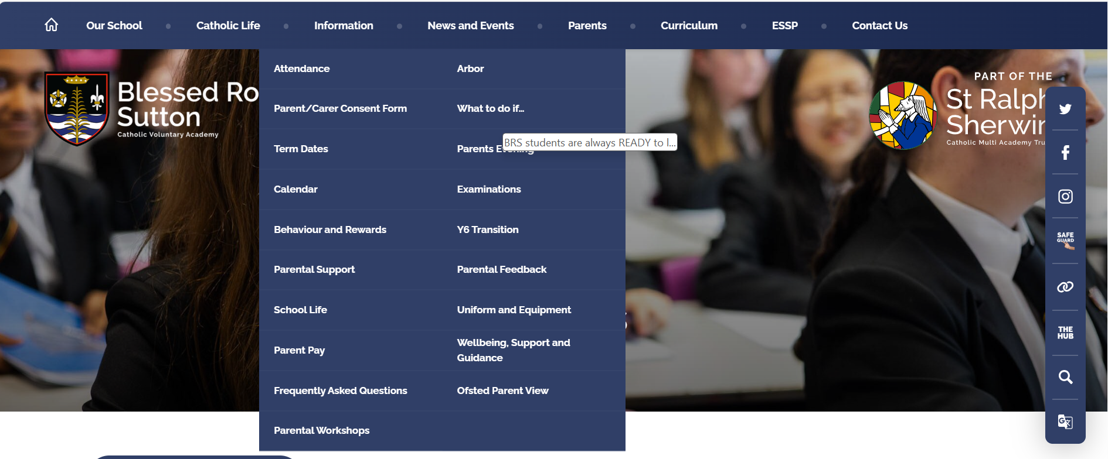
Website

Slide 18
Teaching and Learning –
At Blessed Robert Sutton we deliver a knowledge-rich curriculum that prepares pupils for future learning and inspires pupils to "live life to the full." John, 10:10.
As teachers, we are all committed to becoming the best we can be, and staff engage with weekly CPD and regular quality assurance.

Slide 19
Every morning starts with GRACE

Slide 20
BRS students are always READY to learn...

Slide 21
Behaviour
100% disruption-free learning, every minute of every lesson, every day
Clear behaviour system​
High standards in every aspect​

Slide 22
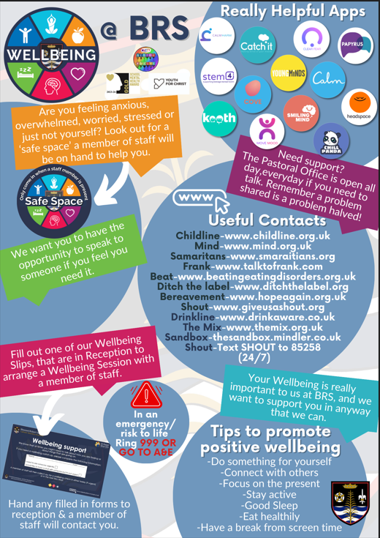
Safeguarding
Safeguarding Team
Mr Hopkins
Designated Safeguarding Lead
Mrs Smith
Deputy Designated Safeguarding Lead
Mrs Miller
Assistant SENCO
Mrs Rowe
Attendance Officer
Pastoral Team
Mr Mills
Miss Upton
Mon, Thu, Fri
Mrs Kucharik
Tues & Wed
Extended Safeguarding Team
Miss Page
Teaching
Assistant
Mrs Gibson
Teaching
Assistant
Miss Miller
Teaching
Assistant
Mrs Brown
Pastoral
Support

Slide 23
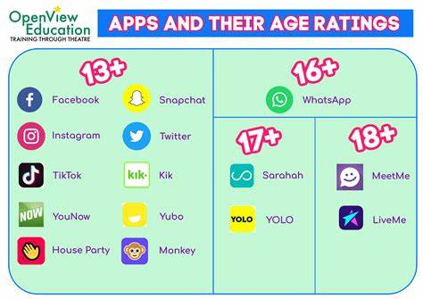
Mobile Phone/Technology
Within the school grounds and school building phones should be
Switched off
Out of sight
Never Heard

Slide 24
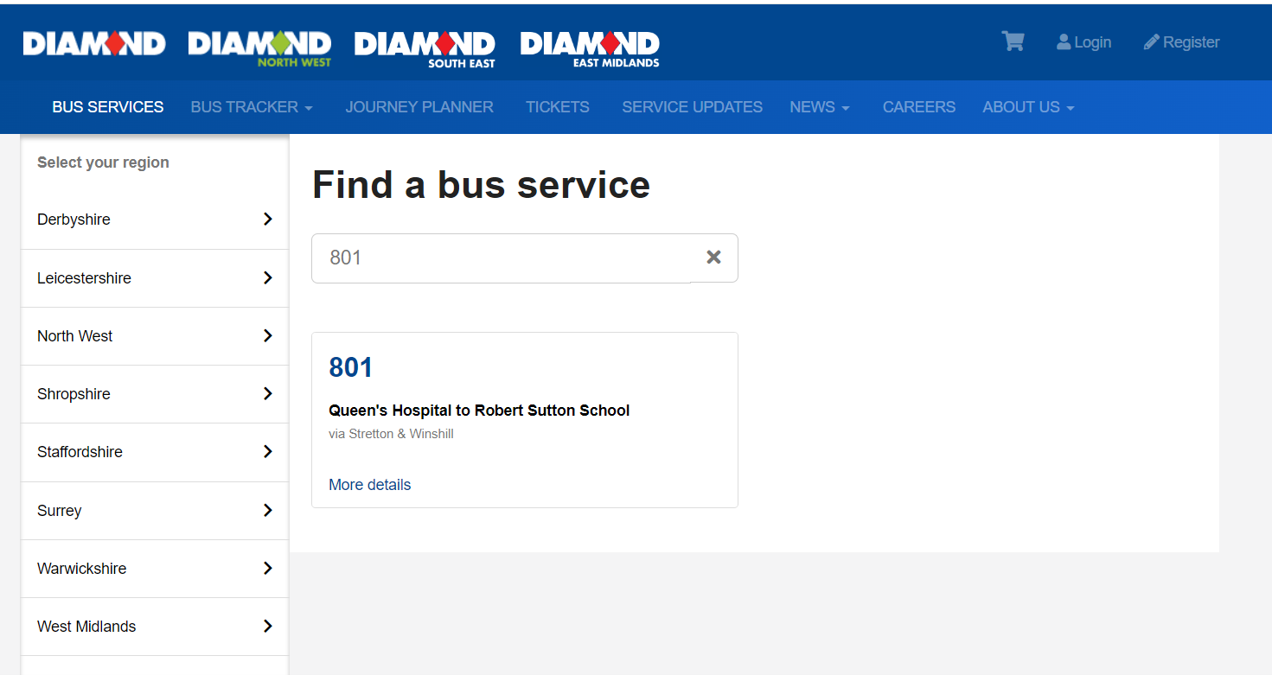
Transport – Diamond
https://www.diamondbuses.com/bus-services/
Support for using the bus will be available everyday.
Staff are on duty every morning and afterschool

Slide 25
Extra Curricular Activities
Session ​ | Aim ​ | When ​
Prep ​ | Access to manned computer room to complete homework or complete revision activities ​ ​ | 8-8:25am Mon-Fri ​ Break​ Lunch ​
Prep +: Homework ​ ​ | Additional Homework time with a TA or to complete independently ​ ​ | 3-4pm Tues-Thurs​

Slide 26
Extra Curricular Activities

Slide 27
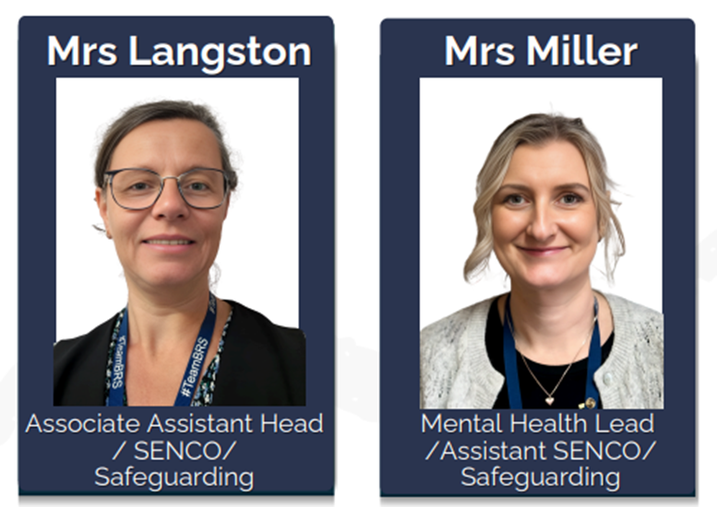
Special Educational Needs
Jenny Langston
SENCO
jlangston@brs.srscmat.co.uk
Sally Miller
Assistant SENCO
smiller@brs.srscmat.co.uk

Slide 28
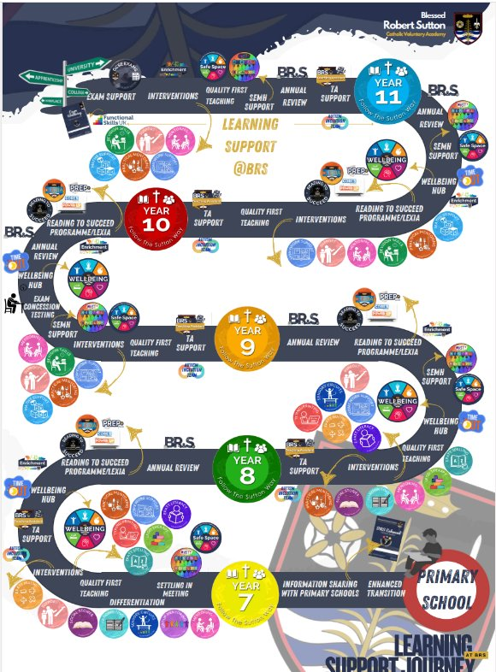

Slide 29
SEN coffee morning

Slide 30
Wellbeing Services in School
Mental Health Support team
6-8 weekly CBT (cognitive behaviour therapy)
A chance to work through worries and develop strategies to implement at school/home
Weekly Listening Support by Burton Youth for Christ Listening Practitioner
Reflective listening
Chance for young people to talk freely and feel heard as they tell their story at their own pace, without feeling judged or that they are a project to be ‘sorted out.’
Can increase resilience levels and empower young people to work through issues themselves
Appointments allocated on needed along with signposting to other BYfC services
School Nurse
Drop in and booked sessions each fortnight
Offered by Families Health and Wellbeing Service 0-19
Professionals from other services
If you are aware of a service supporting your child please let us know – safeguarding@brs.srscmat.co.uk

